Slide 1
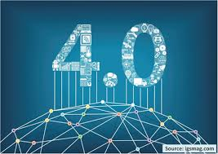

4TH INDUSTRIAL REVOLUTION

Slide 2
WHAT IS 4IR
The Fourth Industrial Revolution is a way of describing the blurring of boundaries between the
Physical, Digital, And Biological Worlds.
It's A Fusion Of Advances In Artificial Intelligence (Ai)
Robotics
The Internet Of Things (Iot)
3D Printing,
Genetic

Slide 3
ETHICAL PERSEPCTIVES IN 4IR
Principles Of Ethical Business Communication
Automation And Employment In The 4IR
Organizational Changes And The “Gig Economy”
Digital, Social And Global Divides
Unreliable Computer Controlled Systems

Slide 4
Principles Of Ethical Business Communication

Slide 5
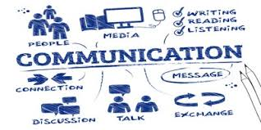
Ethics are moral principles that guide an individual/ group on how they must behave. Business ethics are the principles that people in the workplace must follow, basically it is how an individual must conduct themselves in a workplace.

Slide 6
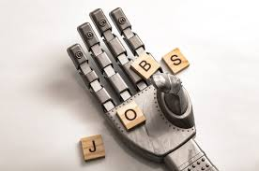
Automation And Employment

Slide 7
The worldwide work environment is progressively evolving with new innovation.
New technology makes it simpler for organizations to automate routine tasks and this could disturb the harmony between job responsibilities and surfacing questions concerning the connection among people and machines.
With smart technology turning out to be more standard, we have to consider the effect utilizing this new innovation will have on our society and workforce.
Artificial intelligence is releasing an unheard of level of efficiency and enlarging our lives from various perspectives.
It's unavoidable that employment will be affected as artificial intelligence automates an assortment

Slide 8

Organizational Changes And The “Gig Economy”

Slide 9

New technologies have the potential to transform work and workplace, displace jobs, create jobs, and impact living conditions.
A pessimistic scenario suggests major loss of jobs, increased insecurity in employment, de-skilling, and growing inequalities, indeed many of the new forms of work are variations of old forms of day labor and irregular employment.
Gig work is a suitable starting point to examine the new economy in action and consider its growth, operations and consequences.

Slide 10
Digital, social and global divides

Slide 11
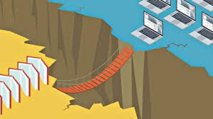
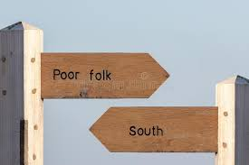
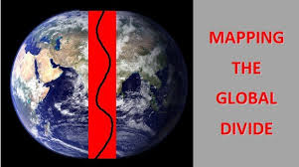
Digital divide
Social divide
Global divide
Digital divide describes that the world is separated into two, people who have and who do not have access to use of modern technologies such telephone, television and the internet.
Digital divide has effect on the education because student who have access to internet can acquire more knowledge from the internet and whilst those who don’t have will not gain anything.
So with 4IR this will remain the same because a lot of people still do not have access to internet until that happens then these revolutions will not be of any success.
Social divide refers to regular patterns of division in the society that are related with participation of specific social groupings, generally in terms of advantages and disadvantages, inequalities and differences.
Social divisions exists with, age, sex, sexuality, race/ethnicity and social class
Global divides describes division between developing countries and developed countries with regards to the access of computing and information resource and it also contributes to the inequality of access to goods and services available with technology.

Slide 12
Unreliable computer-controlled systems

Slide 13
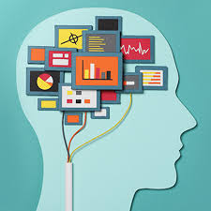
4IR is slowly becoming a necessity into humans’ lives whereby we trust the machine (robots) to perform tasks for us. It is good to reduce the load that should be done by humans into machines but there are certain things that does not need artificial intelligent. Thing that require a human mind, feeling, actions and thoughts.
There are things that people trust 4IR where it needs a human action.
Things like performing a surgery, a machine need a connection to server to and get all the method that it should perform.

Slide 14
Thank You

